Slide 1
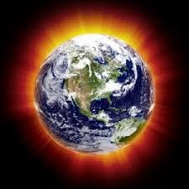
Global Warming
By Ethan Cooper
and Sam Cook

Slide 2
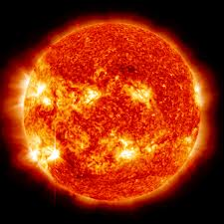
Effects of Global Warming
Global Warming could cause loss of wetlands and can damage water systems, Which increases the number of pollutants ( waste matter that contaminates water, air, or soil) entering the waterways.
Global Warming can harm animals and plants which hurts the humans to.
This has a huge effect on our community, because there are tons of wetlands in our area.

Slide 3
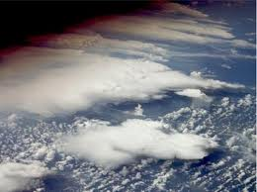
The Ozone Layer
The Ozone Layer is depleting faster and faster each year.
The Ozone Layer has depleted 20% in the mid-1980s

Slide 4
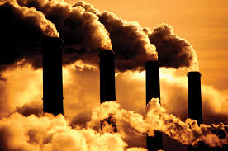
Fossil Fuels
Fossil fuels are natural resources, such as coal, iron and sometimes charcoal. Fossil fuels provide huge amounts of energy, but like few others, it’s not sustainable, and it is massively unhealthy for the planet. Nova Scotia is the only province that still uses fossil fuels.
Fossil fuels have been in Nova Scotia for hundreds of years, especially in Cape Breton, but it is really hurting the environment and causing Global Warming.
The fossil fuel industry's started 1700s

Slide 5
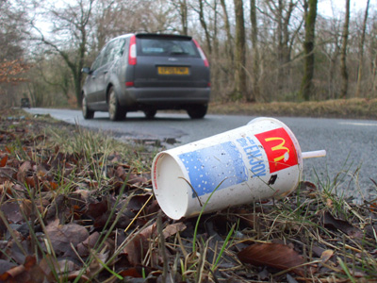
Littering
Littering is one of the smallest things that could cause Global Warming but one of the most important things of Global warming because everyone is doing it.

Slide 6
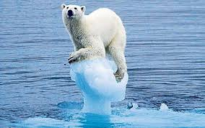
Climate Change
Based Average temperatures have climbed 1.4 degrees Fahrenheit (0.8 degrees Celsius)
With the work of 2500 scientists. They found out that humans have caused all, or most of the current Global Warming effects.
Global Warming that’s caused by humans is called anthropogenic Climate Change

Slide 7
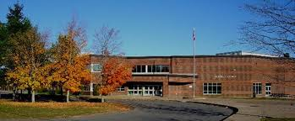
What Will This Affect In Hebbville?
Due to Global Warming, the river temperatures will increase. Because of this, it will cause pre-spawning death in some river fish, and salmon, but it will cause good conditions for tuna, hake, and squid when they migrate to the south. This has a huge affect on Hebbville, as there are many rivers here.

Slide 8
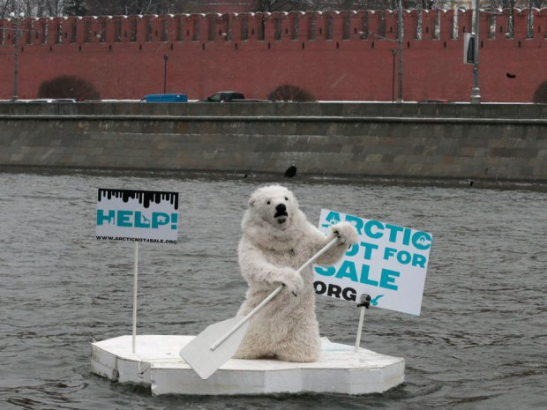
How Can We Help Lower Global Warming Percentages?
Our community can’t stop Global Warming but it can lower the percentages.
Try to stop littering.
Try to save electricity.
Don’t leave car running when it doesn’t need to be on.
Use less hot water.

Slide 9
CREDITS
Created by Ethan and Sam
RESOURCES
The National Geographic
Pictures from Google Images
Thanks For Watching!

